Slide 1

Elmworth Type Curves
May 2025

Slide 2
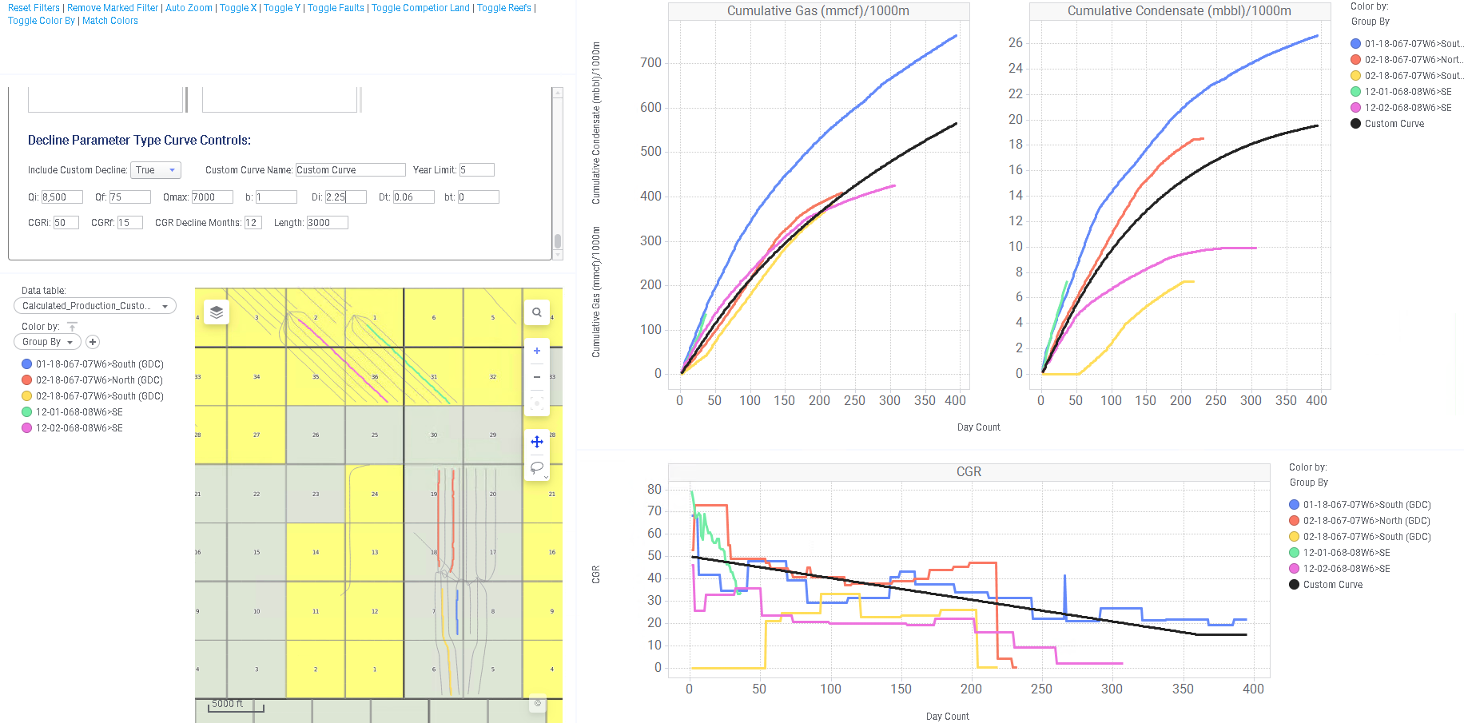
L-Block MNTN A

Slide 3
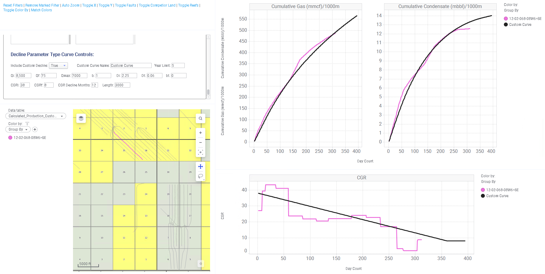
L-Block MNTN B *single datapoint*

Slide 4
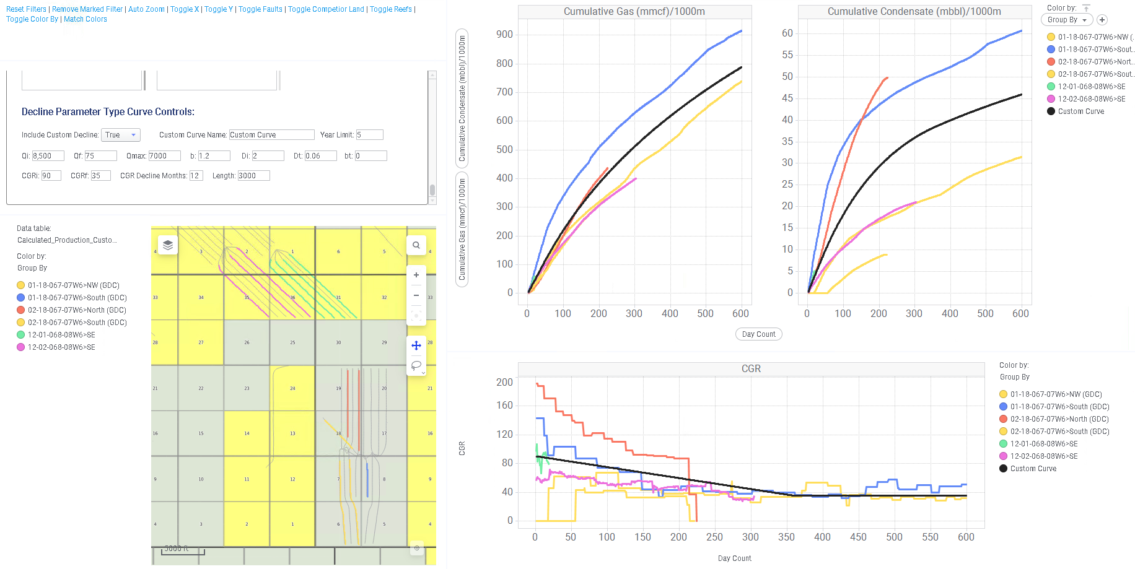
L-Block MNTN C

Slide 5
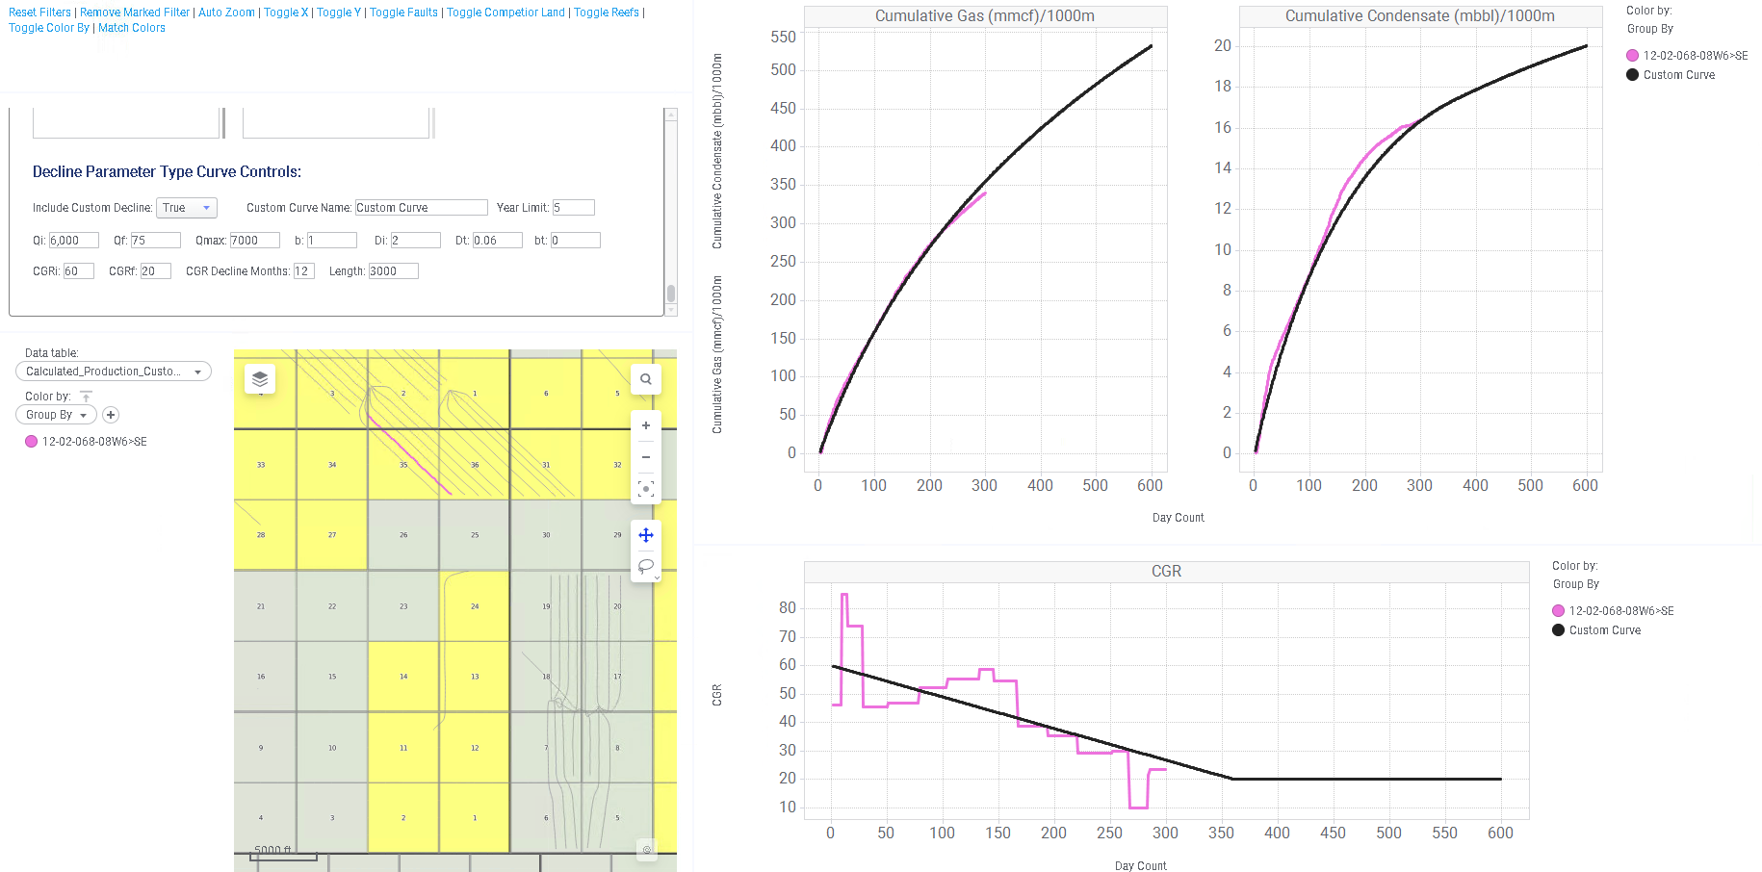
L-Block MNTN D *single datapoint*

Slide 6
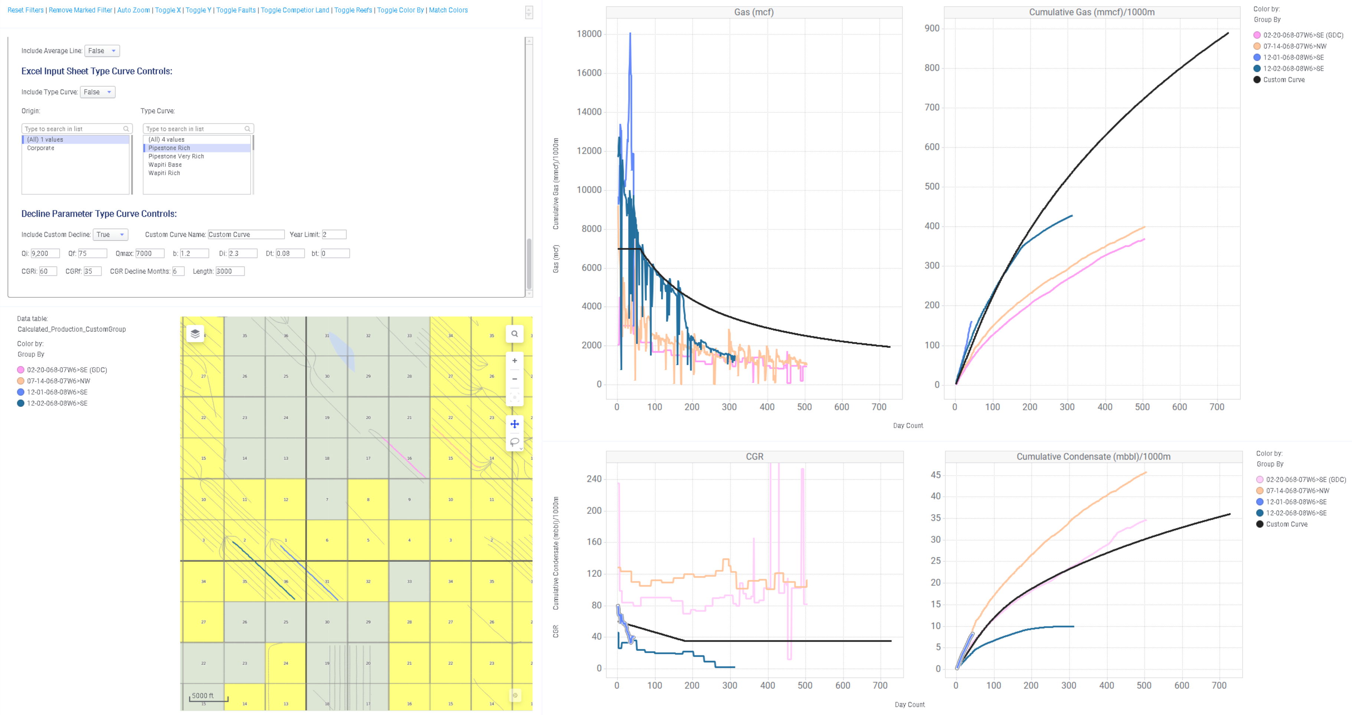
East Elm MNTN A

Slide 7
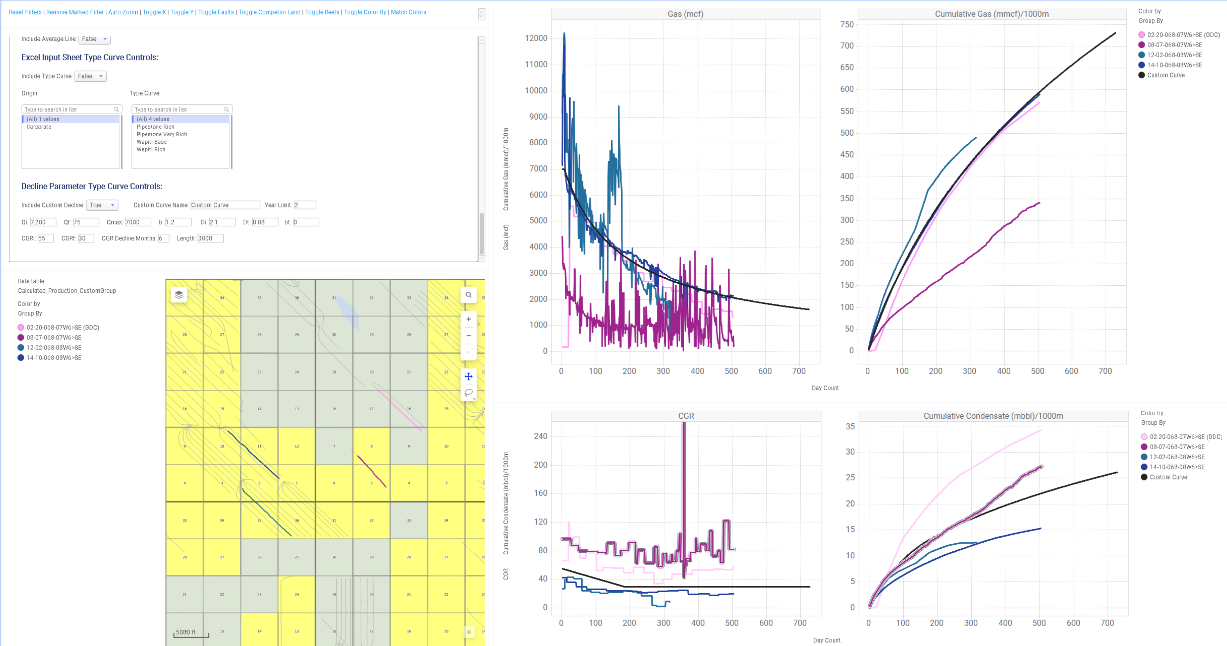
East Elm MNTN B

Slide 8
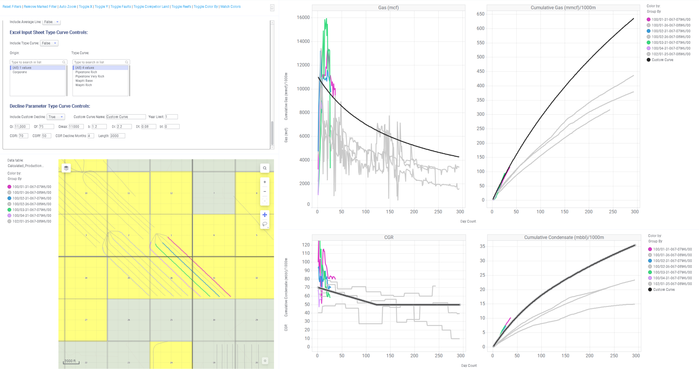
East Elm MNTN C

Slide 9
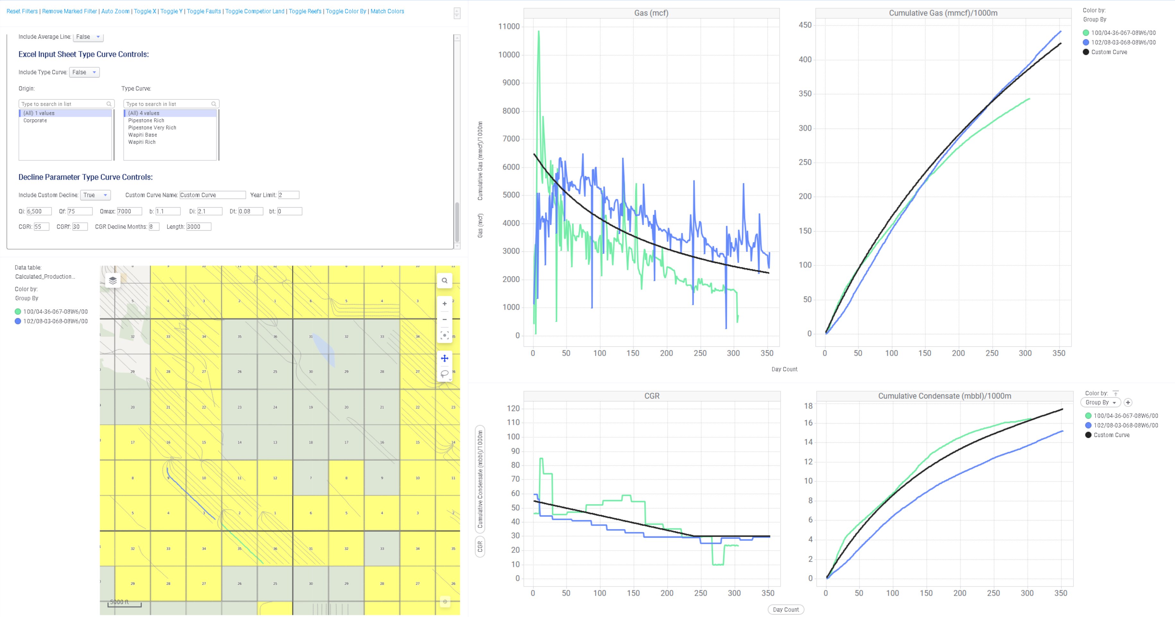
East Elm MNTN D

Slide 10
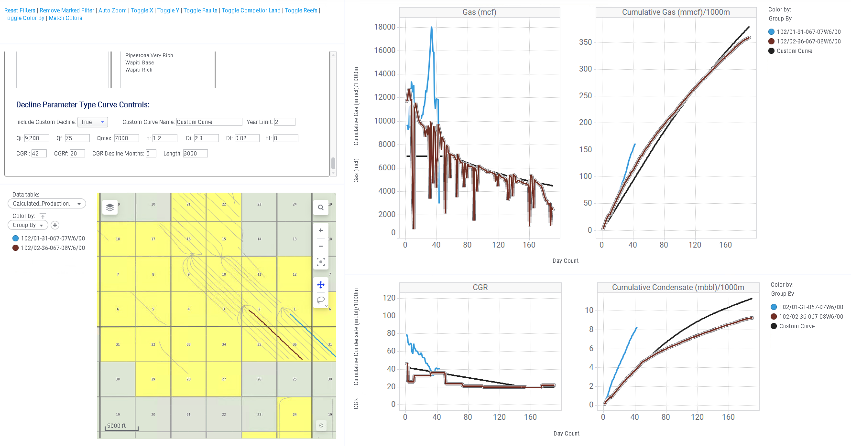
West Elm MNTN A

Slide 11
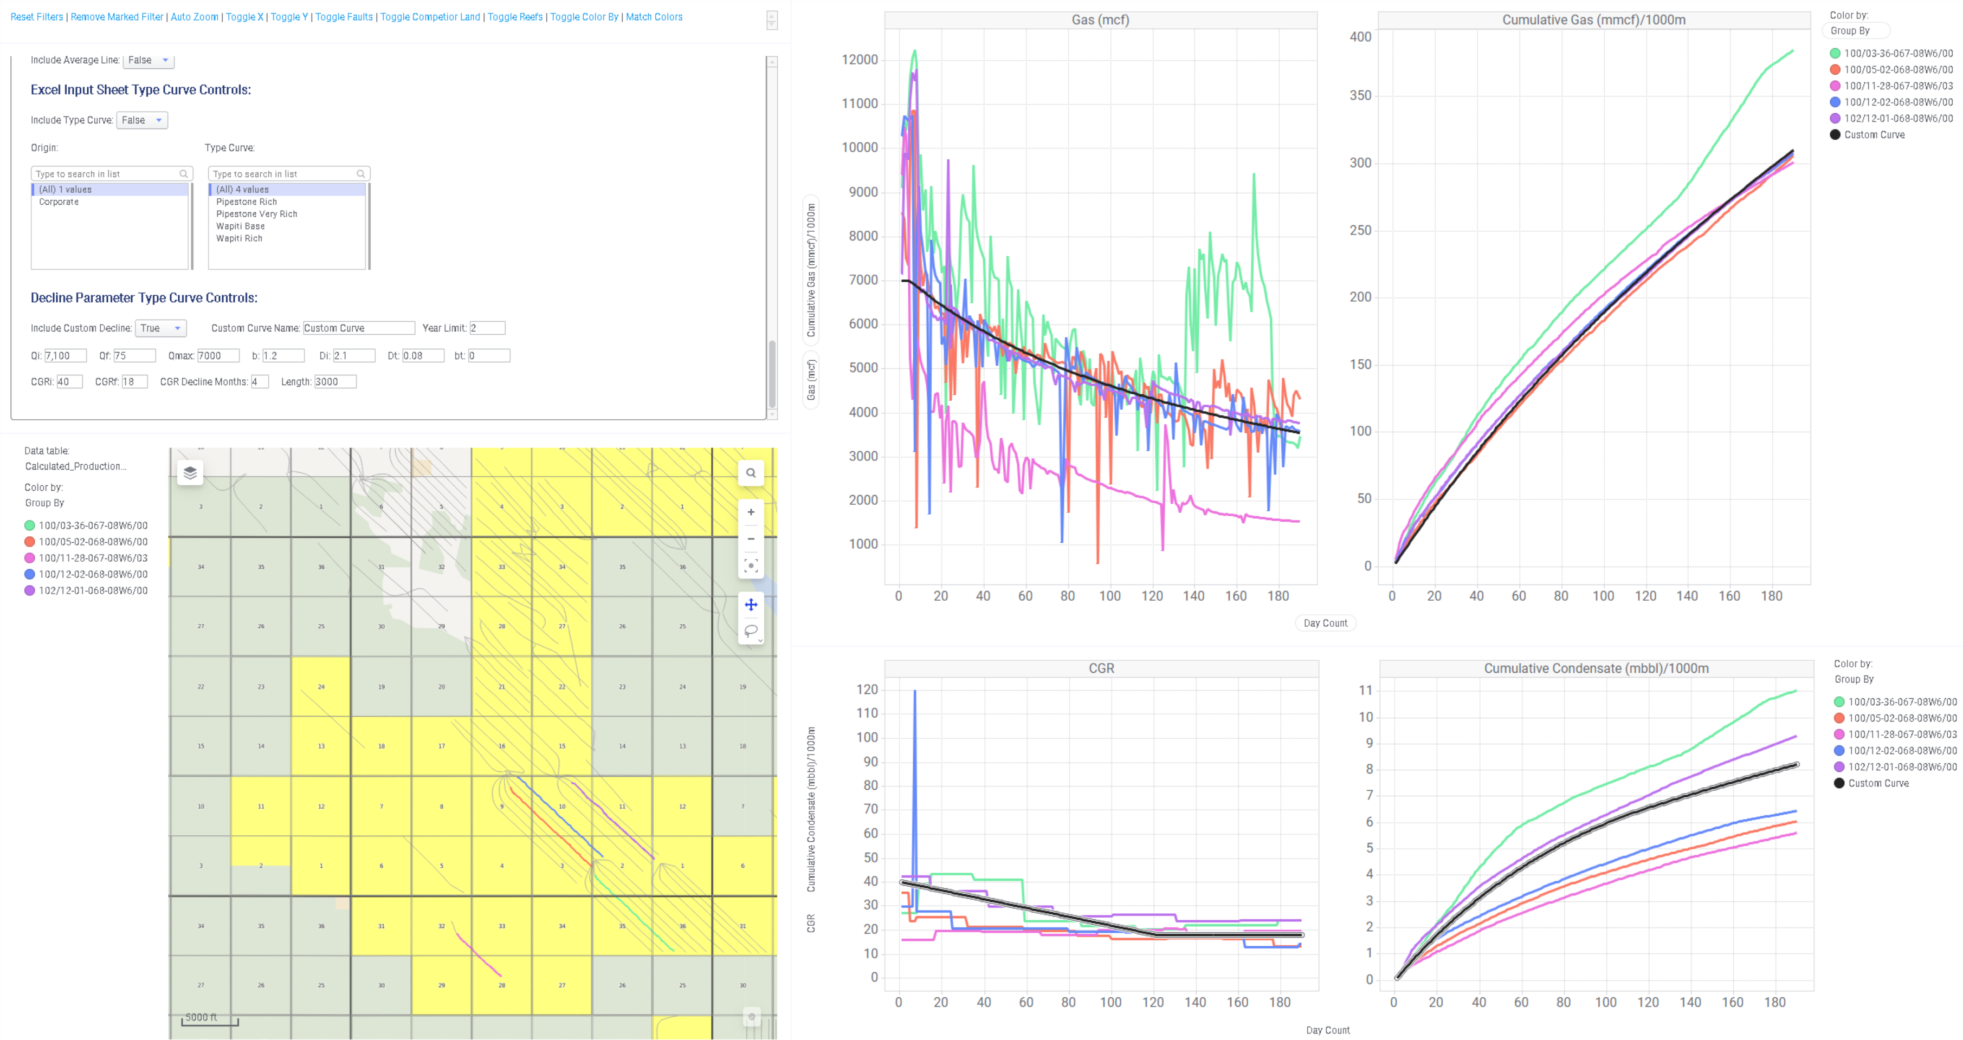
West Elm MNTN B

Slide 12
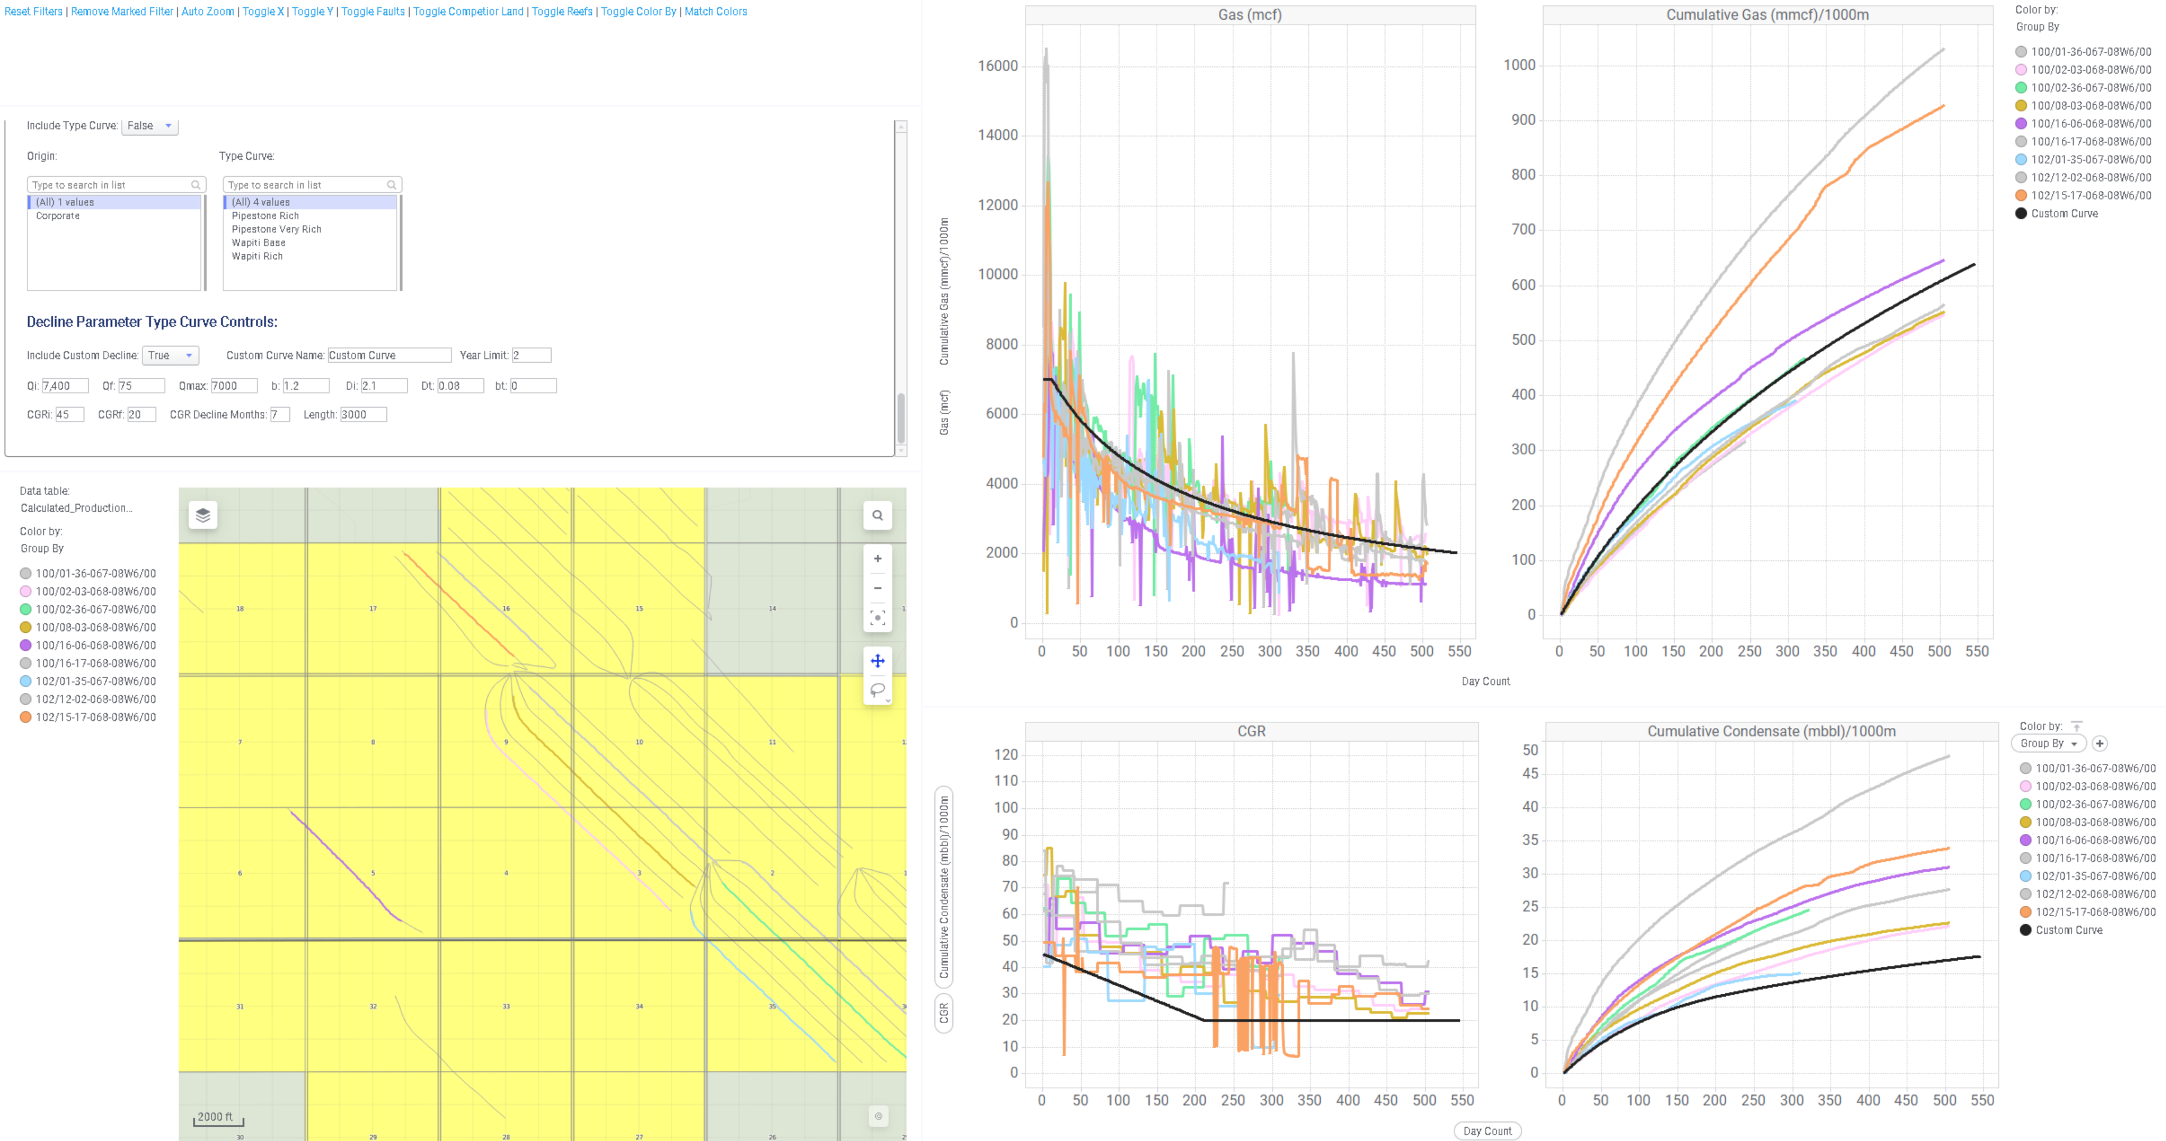
West Elm MNTN C

Slide 13
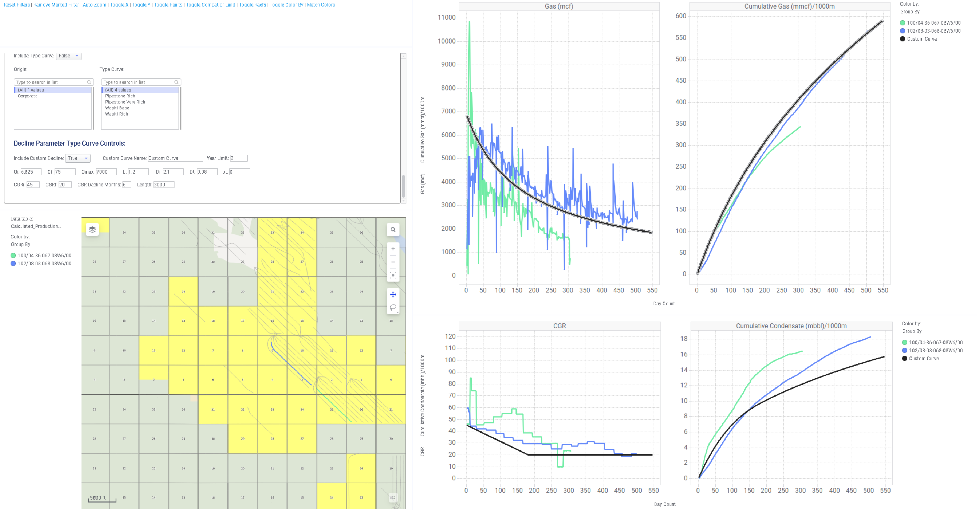
West Elm MNTN D

